Slide 1
Ch 9: Bonds
Prof Andrew Ang
July 2014

Slide 2
Last Class, This Class
LAST CLASS
Ch 8: Equities
How much does the stock market earn, and when?
The equity premium is large, and hard to explain with consumption risk
Expected returns change over time (valuation ratios)
Volatility changes over time and is predictable
THIS CLASS
Ch 9: Bonds
What moves interest rates, and why do riskier bonds pay more?
Monetary policy: the Fed sets the level of rates
Term spread: why long bonds pay more than short ones
Credit spread: why corporate bonds pay more than Treasuries
In one line: Stocks are claims on uncertain cash flows; bonds promise fixed payments. So for bonds, the big risks are interest rates (term) and default (credit).

Slide 3
Same Core Idea
Much of today builds on the last two classes
Idea | Earlier classes | This class (Ch 9)
Bad times drive premiums | Stocks fall when consumption is low → equity premium (Ch 8) | Long and corporate bonds lose in bad times → term and credit premiums
Premiums change over time | The equity premium is high in bad times (Ch 8) | The term premium is high in recessions
Term and credit spreads | Tested as predictors of stock returns (Ch 8) | The term spread predicts recessions; the credit spread prices default
Volatility | VIX and volatility timing (Ch 8) | Credit spreads widen when the VIX rises
Inflation | Stocks are a poor inflation hedge (Ch 8) | Long yields contain expected inflation and an inflation risk premium
Factors | Term and credit were fixed income factors (Ch 6–7) | Where those factor premiums come from
Common thread: A premium is payment for losing money in bad times, for bonds as for stocks.

Slide 4
How Bonds Differ from Stocks
Same tools, different securities
 | Stocks | Bonds
Cash flows | Uncertain dividends | Fixed coupons and principal (unless the issuer defaults)
Main risks | News about cash flows; the equity premium | Interest rates (all bonds) and default (corporate bonds)
Idiosyncratic risk | Large, so diversification helps | Tiny for government bonds: almost all factor risk
Biggest driver | The market factor | The level of rates, set largely by the Fed
Option view | Equity = call option on the firm | Corporate bond = safe bond minus a put option
So: To understand bonds, start with the Fed: it sets the level of interest rates.

Slide 5
Outline
Monetary Policy
1.1 The Fed and the Level of Rates
1.2 What Drives the Fed: The Taylor Rule
1.3 Quantitative Easing
Term Spread (Long Bonds)
2.1 Long Bonds: Risk and Return
2.2 The Term Spread and the Economy
2.3 What Drives Long Yields?
Credit Spread (Corporate Bonds)
3.1 Credit Spreads and Returns
3.2 Default as an Option: The Merton Model
3.3 The Credit Spread Puzzle

Slide 6
Monetary Policy
1.1 The Fed and the Level of Rates
1.2 What Drives the Fed: The Taylor Rule
1.3 Quantitative Easing

Slide 7
Monetary Policy
Part 1.1
The Fed and the Level of Rates
Who sets interest rates, and how closely do all rates move together?

Slide 8
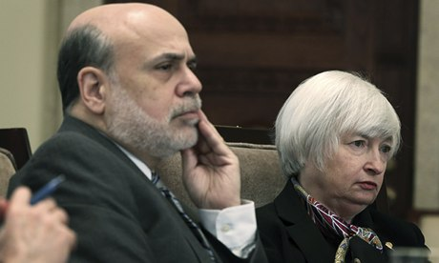
Who Sets Monetary Policy?
Monetary policy is the main force behind interest rates
It is set by the Federal Reserve (the Fed), led by its Chair
Fed Chairs since 1987
Alan Greenspan: Aug 1987 – Jan 2006
Ben Bernanke: Feb 2006 – Jan 2014
Janet Yellen: Feb 2014 – Feb 2018
Jerome Powell: Feb 2018 – May 2026
Kevin Warsh: since May 2026
Ben Bernanke and Janet Yellen

Slide 9
The Fed Funds Rate
The fed funds rate is the interest rate banks charge each other for overnight loans
1. The FOMC sets a target
The Federal Open Market Committee chooses a target for the fed funds rate
2. Banks lend overnight
Banks lend reserves to each other overnight. The average rate is the effective fed funds rate
3. The Fed steers the rate
It buys and sells bonds (open market operations) to keep the market rate near its target
Since 2008, the Fed steers the rate mainly by setting the interest it pays banks on their reserves.
Takeaway: The fed funds rate is the shortest interest rate in the economy, and the anchor for all other rates.

Slide 10
Fed Funds Rate and 3-Month T-Bills
How to read it
Monthly interest rates (%), mid-1950s to 2013
Blue: fed funds rate. Red dashed: 3-month T-bill yield
What we see
The two move almost one-for-one: correlation 0.988
Both peak near 19% in 1981, when the Fed fought inflation
Both near zero after 2008
Takeaway: The Fed effectively sets short-term interest rates.
Notes:
6

Slide 11
Fed Funds Rate and 10-Year Treasuries
How to read it
Blue: fed funds rate. Red dashed: 10-year Treasury yield (%)
What we see
Still a close link: correlation 0.89
The 10-year yield is smoother, and usually above the fed funds rate
The gap widens when the Fed cuts rates in recessions
Takeaway: Even 10-year yields follow the Fed. This common movement is called the level factor.
Notes:
7

Slide 12
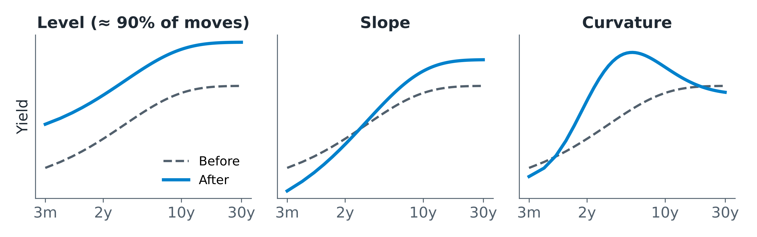
One Factor Moves All Rates: The Level
Yields of all maturities move together. The level factor explains about 90% of the variation in bond yields and returns (Litterman & Scheinkman, 1991)
Exposure to the level factor is duration: % change in bond price ≈ − duration × change in yield. Example: duration 7, yields rise 1 percentage point → price falls about 7%
Takeaway: Monetary policy drives the level factor, by far the most important factor in fixed income.

Slide 13
Monetary Policy
Part 1.2
What Drives the Fed: The Taylor Rule
How does the Fed react to inflation and output?

Slide 14
What Is the Fed Supposed to Do?
The Federal Reserve Act (1977 amendment) asks the Fed to promote “maximum employment, stable prices, and moderate long-term interest rates”
Goal 1: Maximum employment
Keep output and jobs close to the economy’s potential
Goal 2: Stable prices
Keep inflation low and steady
The goals can conflict: raising rates to fight inflation can slow the economy and cost jobs.
So: To explain the level of interest rates, we need to explain how the Fed balances these two goals.

Slide 15

How Does the Fed Decide?
The Fed’s decision process is not fully visible: FOMC minutes come out after three weeks, full transcripts only after five years
In 1993, John Taylor proposed a simple rule describing how the Fed sets the fed funds rate
The Taylor rule is used both to describe what the Fed did and to prescribe what it should do
John Taylor

Slide 16
The Taylor Rule
FF_{t} = r* + π_{t} + 0.5 (π_{t} − π*) + 0.5 Gap_{t}
Symbol | Meaning
FF | Fed funds rate
r* | Long-run (neutral) real interest rate
π | Current inflation
π* | Target inflation
Gap | Output gap: % difference between actual and potential GDP
Key feature
If inflation rises by 1 percentage point, the rule raises the fed funds rate by 1.5 points, so the real rate rises and the economy cools
Many versions exist: forward-looking (using forecasts), backward-looking (past data), or with gradual adjustment
The gap between the actual rate and the rule is called a monetary policy shock
In words: Higher inflation or a stronger economy → higher short rates.

Slide 17
The Taylor Rule: A Worked Example
Assume r* = 2% and target inflation π* = 2%
Scenario | Inflation | Output gap | Fed funds rate
A. Normal times | 2% | 0% | 2 + 2 + 0 + 0 = 4%
B. Inflation jumps | 4% | 0% | 2 + 4 + 1 + 0 = 7%
C. Recession | 2% | −4% | 2 + 2 + 0 − 2 = 2%
A → B: inflation up 2 points, rate up 3 points. The Fed reacts more than one-for-one
A → C: a recession with a −4% output gap cuts the rate by 2 points
So: Short rates are high when inflation is high or the economy is strong, and low in recessions. Keep this in mind for the term spread (Part 2).

Slide 18
Does the Taylor Rule Fit the Data?
How to read it
Dark: actual fed funds rate. Light: rate fitted by a Taylor rule using GDP growth and CPI inflation, 1955–2011
Table: the estimated reaction to each variable
What we see
Inflation coefficient 1.09: 1 point more inflation → about 1.1 points higher rate
The rule tracks the big swings (R² = 0.52)
Big misses: far above the rule in the early 1980s (Volcker); below it in 2002–04 and after 2008
Takeaway: A simple rule explains about half of Fed policy. The misses are policy shocks.

Slide 19
Has the Fed’s Behaviour Changed?
The Fed has two goals. How much weight does it put on each, and has that changed over time?
Ang, Boivin, Dong & Loo-Kung (2011) estimate a Taylor rule whose weights on output and inflation change over time. They also find long-term bonds price the risk of these policy shifts
Early 2000s: after the dot-com recession and 9/11, Greenspan cut rates sharply and kept them low. Critics say rates were “too low for too long”, helping fuel the housing boom
Next: What would rates have been if the Fed had kept its 2000 policy stance?

Slide 20
How Strongly Does the Fed React?
How to read it
Red: the Fed’s estimated weight on the output gap (top) and on inflation (bottom), 1955–2005
Yellow bars: recessions. Thin green lines: error bands
What we see
Weight on output: small and fairly stable (about 0.5)
Weight on inflation: highest in the early 1980s (Volcker), high in the late 1990s, near zero around 2003
Takeaway: The Fed’s reaction to inflation is not constant over time.
Source: Ang, Boivin, Dong & Loo-Kung (2011)
Notes:
14

Slide 21
Too Low for Too Long?
How to read it
Red: actual. Blue dashed: rates if the Fed had kept its average 2000 policy weights
Top: short rate. Bottom: 5-year bond spread over the short rate
What we see
2002–05: the actual short rate was about 1%, versus 2.5–5% under the 2000 stance
A low short rate made the actual spread wider
Source: Ang, Boivin, Dong & Loo-Kung (2011)
Takeaway: Policy was much looser than the Fed’s own past behaviour implied.
Notes:
15

Slide 22
Monetary Policy
Part 1.3
Quantitative Easing
What does the Fed do when short rates hit zero?

Slide 23
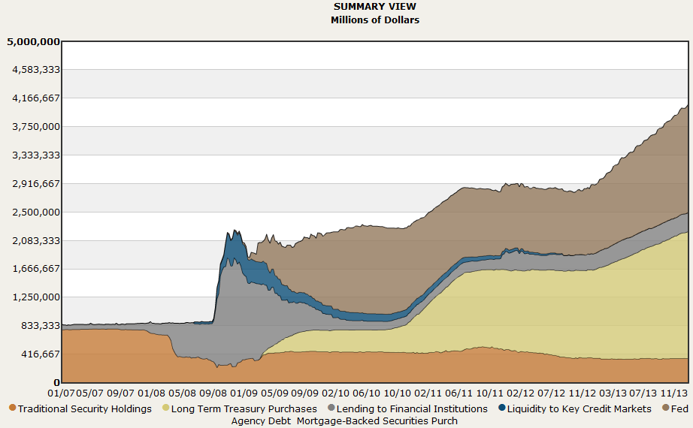
Quantitative Easing: The Fed’s Balance Sheet
How to read it
Fed assets by type, $ millions, 2007–2013 (Cleveland Fed)
What we see
Before 2008: about $0.9 trillion, mostly Treasuries
Late 2008: emergency lending to banks and markets spikes (TAF, AIG, commercial paper)
From 2009: purchases of long-term Treasuries and mortgage bonds push assets to about $4 trillion
Takeaway: With short rates at zero, the Fed moved long rates by buying long bonds.

Slide 24
Since 2014: QE and QT
The chart stops in 2013. Since then, balance-sheet policy has gone both ways:
2014
QE purchases end at about $4.5 trillion
2017–19
First “quantitative tightening” (QT) shrinks assets to about $3.8 trillion
2020
COVID: rates back to zero and large new QE
2022
Assets peak near $9 trillion; QT restarts as rates rise
Dec 2025
QT ends at about $6.6 trillion
QE = the Fed buys long bonds to push long rates down. QT = it lets them run off, so long rates face upward pressure.
Takeaway: Buying and selling long bonds is now a standard tool, alongside the fed funds rate.

Slide 25
Term Spread (Long Bonds)
2.1 Long Bonds: Risk and Return
2.2 The Term Spread and the Economy
2.3 What Drives Long Yields?

Slide 26
Term Spread (Long Bonds)
Part 2.1
Long Bonds: Risk and Return
Do long bonds pay more than short ones, and how risky are they?

Slide 27
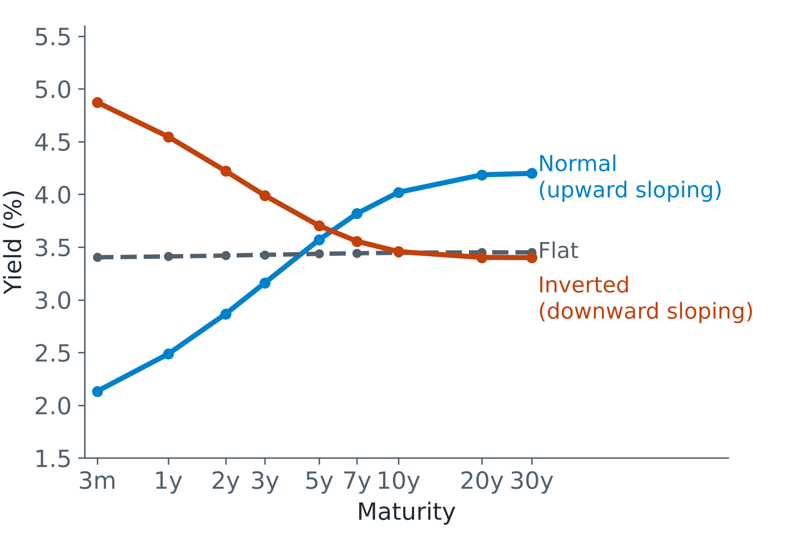
What Is the Yield Curve?
Definitions
Yield curve: yields on government bonds of different maturities, on one day
Term spread: long yield − short yield, e.g. 10-year minus 3-month
Normal: long above short (spread > 0)
Inverted: short above long (spread < 0)
Takeaway: Part 2 asks why long bonds usually yield more, and what the slope tells us about the economy.

Slide 28
Long Bonds: Return, Risk and Sharpe Ratio
US Treasuries by maturity, 1952–2011 (returns in excess of T-bills, % per year)
 | 1–12m | 1–2y | 2–3y | 3–4y | 4–5y | 5–10y | >10y | Stocks
Excess return | 0.59 | 1.05 | 1.39 | 1.60 | 1.61 | 1.91 | 2.97 | 6.45
Volatility | 0.81 | 2.08 | 3.18 | 4.00 | 4.73 | 5.81 | 9.27 | 14.76
Sharpe ratio | 0.73 | 0.51 | 0.44 | 0.40 | 0.34 | 0.33 | 0.32 | 0.44
Longer maturity → higher average return (0.6% → 3.0% a year): a term premium
But volatility rises much faster (0.8% → 9.3%), so the Sharpe ratio falls with maturity (0.73 → 0.32)
Long bonds are as volatile as two-thirds of the stock market, but earn less than half the stock premium
Takeaway: There is a term premium, but it is modest, and it depends a lot on the period (next slides).

Slide 29
Treasury Returns by Maturity and Period
How to read it
Average excess return over T-bills for each maturity bucket
One line per period
What we see
1952–82, when rates rose: long bonds lost money (−0.6% a year for 10y+)
1983–2011, when rates fell: 10y+ bonds earned 5.7% (7.2% in 2000–11)
Full sample: a gentle rise, 0.6% → 3.0%
Takeaway: Long-bond returns depend on whether rates rose or fell: the level factor again.

Slide 30
Treasury Sharpe Ratios by Maturity
How to read it
Sharpe ratio = excess return ÷ volatility, for each maturity and period
What we see
In every period, the Sharpe ratio falls with maturity
1983–2011: 1.51 for short bonds vs 0.58 for 10y+
1952–82: 0.46 vs −0.07
Takeaway: Investors earn less per unit of risk on long bonds than on short ones.

Slide 31
Bond Risk Is Almost All Factor Risk
Government bonds have tiny idiosyncratic risk (well under 1%): a 5-year bond’s return is 99% correlated with a 5.5-year bond’s, which is 99% correlated with a 6-year bond’s, and so on
Why? The cash flows are fixed. The only question is whether the issuer pays, and if it pays the 5-year bond, it pays the 4-year bond too
So holding many bonds adds little diversification
Idiosyncratic risk rises with credit risk:
Sovereigns
Agencies
Investment-grade corporates
High yield
Low idiosyncratic risk → high idiosyncratic risk
Takeaway: For bonds, what matters is exposure to a few factors: level, slope, and credit.

Slide 32
Term Spread (Long Bonds)
Part 2.2
The Term Spread and the Economy
Why does an inverted yield curve warn of recessions?

Slide 33
The Term Spread Predicts Recessions
A low or negative term spread has warned of slowdowns
NBER recession | Inverted yield curve before?
Dec 1969 – Nov 1970 | Yes
Nov 1973 – Mar 1975 | Yes
Jul 1981 – Nov 1982 | Yes
Jul 1990 – Mar 1991 | Yes
Mar 2001 – Nov 2001 | Yes
Dec 2007 – Jun 2009 | Yes
Feb 2020 – Apr 2020 | Yes (2019), but the recession was caused by COVID-19
No recession | Curve inverted Oct 2022 – Dec 2024: a false signal so far
Inversion = 10-year yield below 3-month yield. Key papers: Harvey (1988), Estrella & Mishkin (1998), Ang, Piazzesi & Wei (2006).
Takeaway: A strong historical signal, but not a perfect one.

Slide 34
Real GDP Growth and the Term Spread
How to read it
Dark bars: real GDP growth (%), 1962–2011
Light line: term spread (10-year minus 3-month)
Grey bands: recessions
What we see
The spread drops, often below zero, before each recession
GDP growth falls afterwards
Takeaway: The term spread moves first; growth follows.
Notes:
22

Slide 35
Why Does the Term Spread Predict the Economy?
Two forces from Part 1 and Ch 8 move the two ends of the curve
In a recession
Short rates low: the Fed cuts (Taylor rule)
Long yields relatively high: investors want a big risk premium in bad times
→ Steep, upward-sloping curve
Late in an expansion
Short rates high: the Fed hikes to cool inflation
Long yields lower: smaller risk premium; markets expect future cuts
→ Flat or inverted curve; a slowdown often follows
Long-bond risk premiums are countercyclical: high in bad times, as for the equity premium in Ch 8.
Takeaway: Fed policy plus time-varying risk premiums make the term spread a business-cycle indicator.

Slide 36
Term Spread (Long Bonds)
Part 2.3
What Drives Long Yields?
Expected short rates, inflation, risk premiums, and more

Slide 37
What Is in a Long Yield?
View 1: through future Fed policy
Long yield =
Average expected short rate
+
Term premium
View 2: through inflation
Long yield =
Real yield
+
Expected inflation
+
Risk premium
Short rates are set directly by the Fed. Long rates reflect investors’ expectations of future policy and the economy
Without the risk premium (dark blocks), these are the Expectations Hypothesis and the Fisher Hypothesis
Takeaway: If the Taylor rule drives short rates, growth and inflation must show up in long yields too, plus risk premiums.

Slide 38
What Moves Long Yields? The Evidence
85%
of the variation in short rates is explained by inflation and output
The “macro-finance” literature, starting with Ang & Piazzesi (2003), links yields to growth, inflation and monetary policy
Macro factors explain short rates well, long yields much less
The term spread is very sensitive to expected inflation and the inflation risk premium
Bond prices help forecast GDP, and monetary policy risk is priced in long bonds
The rest of long-yield movements: other forces such as liquidity and foreign demand (next slides)
40%
of the variation in long yields is explained by inflation and output
Takeaway: Macro and the Fed explain a lot of the yield curve, but not all of it.

Slide 39
Inside the Yield Curve: Inflation Risk
Nominal yield = real rate + expected inflation + inflation risk premium (Ang, Bekaert & Wei, 2008; 1952–2004)
Average level (%) | Real rate | Expected inflation | Inflation risk premium | Total
Short yield | 1.24 | 3.94 | 0.31 | 5.49
Long yield | 1.32 | 3.94 | 1.14 | 6.40
Share of long-yield variance | Real rate | Expected inflation | Inflation risk premium | Total
 | 20% | 70% | 10% | 100%
The long yield is 0.9 points above the short yield, and 0.8 of that gap is the inflation risk premium
Movements in long yields come mostly from changes in expected inflation
Takeaway: The upward slope of the yield curve is mainly payment for bearing inflation risk.

Slide 40
Liquidity and the Term Spread
How to read it
Black: 10-year minus 3-month spread (left axis, %), 2006–2009
Red dashed: on-the-run minus off-the-run Treasury spread (right axis, bp)
The red line measures liquidity: newly issued bonds trade at a premium when investors want liquidity
What we see
Both near zero in 2006–07, both up sharply in 2008
Correlation 0.69
Takeaway: Liquidity is one non-macro force behind the term spread.
Notes:
27

Slide 41
Foreign Demand for Treasuries
How to read it
Panel A: share of Treasuries held by foreign investors
Panel B: net Treasury issuance and net foreign purchases, % of GDP
What we see
Foreign share: under 10% in the 1960s, about 55% by 2008
In the 2000s, foreign buyers absorbed much of the new supply
Takeaway: Large, price-insensitive foreign demand may have pushed long yields down (Greenspan’s 2005 “conundrum”).
Notes:
28

Slide 42
Credit Spread (Corporate Bonds)
3.1 Credit Spreads and Returns
3.2 Default as an Option: The Merton Model
3.3 The Credit Spread Puzzle

Slide 43
Credit Spread (Corporate Bonds)
Part 3.1
Credit Spreads and Returns
How much extra do corporate bonds pay, and how much do investors keep?

Slide 44
What Is a Credit Spread?
Average spread over Treasuries by rating, 1987–2011 (%)
Definitions
Credit spread = corporate bond yield − Treasury yield of the same maturity
It pays for: expected default losses, the risk of default losses, and liquidity, taxes and other features
Aaa
0.93
Aa
1.09
A
1.45
Baa
2.09
Caa
10.19
Aaa to Baa = investment grade; Ba and below (e.g. Caa) = high yield (“junk”). Data: original slide on corporate bond returns.
Takeaway: Lower rating → wider spread. How much of it do investors actually keep?

Slide 45
Corporate Bond Spreads over Time
How to read it
Yield spread over Treasuries by rating, 1973–2012
In decimals: 0.05 = 5 percentage points
What we see
Aaa, A, Baa: usually 1–3%, rising in recessions
Caa: huge and volatile, peaking near 25–30% in 1990–91, 2001–02 and 2008–09
All spreads jump together in bad times
Takeaway: Credit spreads widen in bad times, most of all for the riskiest bonds.
Notes:
31

Slide 46
Do Investors Earn the Credit Spread?
Corporate bond returns, Jan 1987 – Dec 2011 (% per year)
 | Aaa | Aa | A | Baa | Caa | Treasuries
Average yield | 6.20 | 6.35 | 6.72 | 7.35 | 15.45 | 5.26
Spread over Treasuries | 0.93 | 1.09 | 1.45 | 2.09 | 10.19
Excess return over Treasuries | 0.32 | 0.42 | 0.43 | 1.04 | 0.86
Volatility of excess return | 2.61 | 2.92 | 4.00 | 4.70 | 16.00
Sharpe ratio | 0.12 | 0.14 | 0.11 | 0.22 | 0.05
Spreads are large, but investors keep much less: Aaa bonds yield 0.93 points more than Treasuries, yet earned only 0.32 more
Ilmanen (2011): only about 30–60 bp of the spread is a true credit and illiquidity premium; the rest is offset by defaults, downgrades and embedded options
Takeaway: Realized credit premiums are small. Caa bonds offer a 10% spread but had the worst Sharpe ratio.

Slide 47
Credit Spread (Corporate Bonds)
Part 3.2
Default as an Option: The Merton Model
Why do credit spreads rise with volatility and leverage?

Slide 48
The Merton Model: Default as a Barrier
A firm defaults when the value of its assets (V) falls below what it owes: the default barrier
Merton (1974): seen this way, corporate debt is an option on the firm’s assets
In the diagram: firm value starts at V₀, wanders over time, and the firm defaults the first time V hits the barrier
V₀ = value of the firm at t=0
Barrier level
Time
t=0
t=time to default

Slide 49
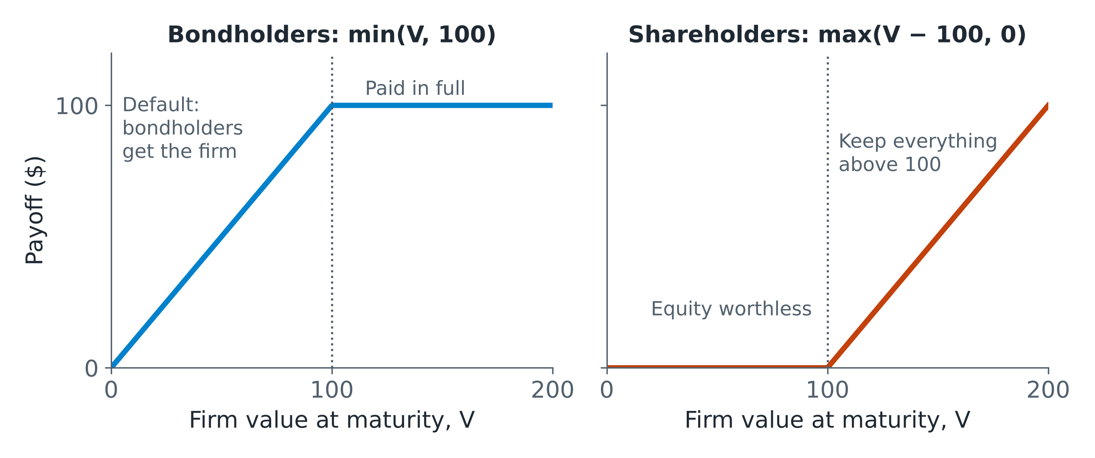
Bondholders Write a Put Option
Payoff at maturity (debt = $100) | V < 100 | V > 100
Hold a risk-free bond | 100 | 100
Write a put (strike 100) | V − 100 | 0
Total = corporate bond | V | 100
Bondholders = safe bond − put: they are short volatility
Shareholders hold a call: they are long volatility
So: Corporate bond = Treasury − put option on the firm’s assets.

Slide 50
What Makes the Credit Spread Wider?
Credit spread = value of the put option = risk-free loan − risky loan
The spread is wider when…
Volatility is higher
Assets are more likely to fall below the barrier
Leverage is higher
The barrier is closer to today’s asset value
Maturity is longer
More time for assets to fall below the barrier
Higher asset volatility raises the value of equity (a call) and lowers the value of debt (bondholders are short the put).
Takeaway: Prediction: credit spreads should widen when volatility rises. Next, we check this with the VIX.

Slide 51
Credit Spreads and Volatility: Baa Bonds
How to read it
Blue dashed: VIX (left axis)
Black: Baa minus Treasury yield spread (right axis, %)
1986–2013
What we see
The two move together: correlation 0.64
Both spike in 1998, 2001–02 and 2008, when the Baa spread nears 8%
Takeaway: As the Merton model predicts, spreads widen when volatility rises.
Notes:
36

Slide 52
Credit Spreads and Volatility: Caa Bonds
How to read it
Blue dashed: VIX (left axis)
Black: Caa minus Treasury yield spread (right axis, %)
What we see
Again they move together: correlation 0.56
Junk spreads peak near 28% in 1991 and 2009
The link is a little weaker: junk spreads also follow default waves
Takeaway: Volatility matters for all credit, but the riskiest bonds have their own default cycle.
Notes:
37

Slide 53
Credit Spread (Corporate Bonds)
Part 3.3
The Credit Spread Puzzle
Why are spreads so much wider than expected default losses?

Slide 54
Credit Spread Puzzle (1): Hard to Explain
Expected loss from default = default probability × (1 − recovery rate)
25%
of spread changes explained by default-risk variables
Variables that should drive default risk (leverage, the VIX, stock returns, interest rates) explain only about a quarter of changes in credit spreads (Collin-Dufresne, Goldstein & Martin, 2001)
The unexplained part moves together across firms, driven by one common factor
Likely cause: market-wide supply and demand for corporate bonds, unrelated to credit risk
40%
with liquidity and macro conditions added
Puzzle 1: Most movements in credit spreads are not about default risk.

Slide 55
Credit Spread Puzzle (2): Too Wide
Corporate spreads are many times wider than expected default losses (Huang & Huang, 2002)
 | Aaa | Aa | A | Baa | Caa
Average spread, 1987–2011 (%) | 0.93 | 1.09 | 1.45 | 2.09 | 10.19
Annual credit loss rate, 1982–2008 (%) | 0.000 | 0.025 | 0.023 | 0.124 | 13.3
Spread ÷ loss rate | — | ≈ 44× | ≈ 63× | ≈ 17× | < 1×
Credit loss = default and recovery (Moody’s). Spreads from the corporate bond returns slide.
The spread should exceed expected losses: defaults cluster in recessions, so investors want a risk premium (the bad-times logic again)
But for investment grade it is far too wide, except for the riskiest (speculative) bonds
Possible reasons: taxes, embedded call/put options, illiquidity, and default risk that rises in bad times
Puzzle 2: Investment-grade spreads are mostly not about expected default losses.

Slide 56
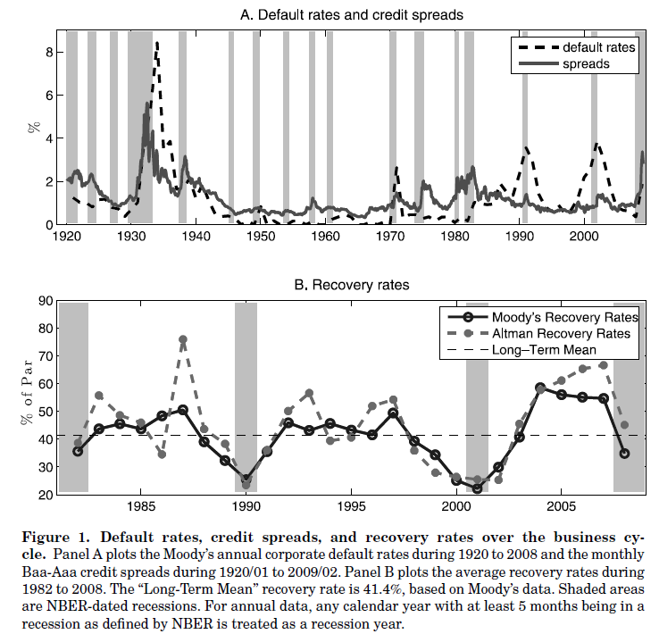
Defaults, Spreads and Recoveries over the Cycle
How to read it
Panel A: default rates (dashed) and Baa−Aaa spreads (solid), 1920–2008
Panel B: recovery rates, % of face value, 1982–2008
Grey bands: recessions
What we see
Defaults spike in recessions, above 8% in the 1930s
Recoveries fall in recessions, to about 20–25% vs a 41% average
Takeaway: Defaults rise and recoveries fall at the same time, in bad times. That makes credit riskier than the averages suggest.
Source: Chen (2010)
Notes:
40

Slide 57
150 Years of Corporate Bonds
Giesecke et al. (2011): US corporate bonds over 150 years, 1866–2008
1.5%
average annual default rate
× 50%
loss given default
≈ 0.75%
average credit loss
1.53%
average credit spread
So about 0.8 points, half the spread, is a premium for bearing default risk
Defaults come in waves: over 15% in the 1870s (railroad crash), over 6% in the 1930s, 3% in 2001–02
Default rates can be forecast by macro variables, but credit spreads cannot, and spread changes do not predict later defaults
Takeaway: Over 150 years, investors were paid about twice the expected loss for holding corporate bonds.

Slide 58
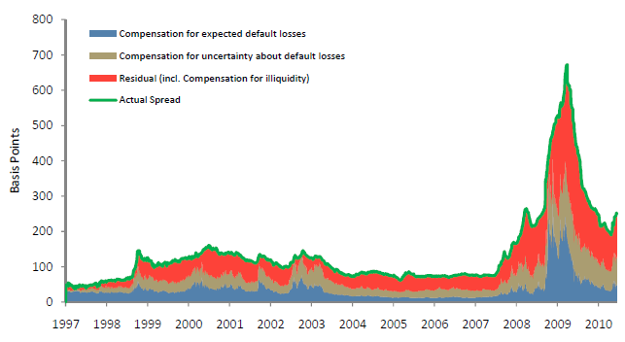
Breaking Down the Spread
How to read it
UK investment-grade spreads, basis points, 1997–2010 (Webber & Churm, 2007)
Blue: expected default losses. Tan: pay for uncertainty about losses. Red: the rest, incl. illiquidity. Green: actual spread
What we see
Before 2007: about 100–150 bp, and expected losses are a thin slice
2008–09: the spread jumps to about 650 bp, mostly illiquidity and risk pay
Takeaway: Expected losses are a small part of spreads. In crises, illiquidity dominates.

Slide 59
Credit Spreads and Liquidity
How to read it
Black: Baa minus Treasury spread (left axis, %), 2006–2009
Red dashed: on-the-run minus off-the-run Treasury spread (right axis, bp), a liquidity measure
What we see
Both rose from about 1% in 2006 to about 8% at the end of 2008, then fell together
Correlation 0.96
Takeaway: In the crisis, credit spreads moved almost one-for-one with market liquidity.
Notes:
43

Slide 60
Summary

Slide 61
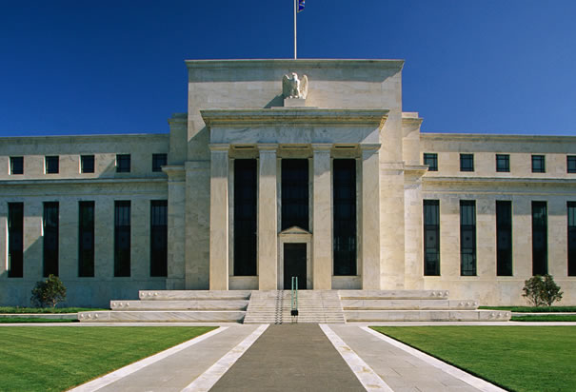
Summary
1. Monetary policy
The Fed sets short rates, and through them the level factor (≈ 90% of yield moves)
Taylor rule: rates rise with inflation and output
At zero rates: QE and QT
2. Term spread
A modest term premium; Sharpe ratios fall with maturity
The spread is countercyclical and has warned of recessions, though not always
The slope is mostly inflation risk pay
3. Credit spread
Corporate bond = Treasury − put (Merton): spreads rise with volatility and leverage
Spreads are far wider than expected losses: defaults cluster in bad times, and liquidity matters
Takeaway: Watch the Fed: it sets the level factor that drives most bond returns.

